Slide 1












NIMEESHA
IFRA NAZZ
Autonomous Gaming Cab
A Reinforcement Learning Journey

Slide 2







Table Of Contents
project topic
Deliverables
OBJECTives
Methodology
Approch

Slide 3
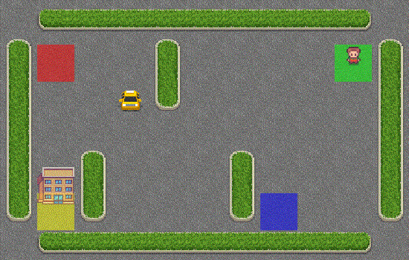





project topic
We are going to train an agent, cab to self drive itself, pick-up a passenger and drop him of at the designated location. Fast, time efficient and following all safety rules.
Pick up passenger and drop him/her off at the right location
Be time efficient as possible by taking less turns and easiest route
Observe safety rules
Rewards are assigned to the cab based on the route selected, location dropped etc.

Slide 4



Statement of Project Objectives
The objective of this project is to develop a self-driving cab using reinforcement learning in Python.
Train the self-driving cab to navigate an environment, pick up a passenger, and drop them off at the correct destination.
Implement a Q-learning algorithm to enable the cab to make intelligent decisions based on rewards and penalties.
Optimize the cab's route to be time-efficient while adhering to safety rules.
Demonstrate the application of reinforcement learning in solving real-world problems.

Slide 5


Approach
Q-learning algorithm
to update Q-values and enable the cab to make informed decisions.
.
Python
programming language for coding and implementation.
E and e strategy
Exploration and exploitation strategy to balance learning and exploitation.
Gym library
for creating and managing the taxi environment.
.
Simulated environmenT
Data visualization
for testing and training the self-driving cab.
to monitor the cab's progress and learning.

Slide 6





Deliverables
Python code for the self-driving cab using reinforcement learning.
A report documenting the project, including explanations of the code and algorithms used.
Visualization of the cab's learning progress, including training episodes and rewards.
A video demonstration of the self-driving cab in action
A summary of lessons learned and insights gained from the project.
Documentation on setting up the development environment and running the project.

Slide 7



Evaluation Methodology
Performance Metrics: Measure the cab's ability to successfully pick up and drop off passengers, its time efficiency, and adherence to safety rules.
Q-value Convergence: Evaluate whether the Q-values converge over time, indicating the cab's learning progress.
Exploration vs. Exploitation: Analyze the balance between exploration and exploitation to ensure effective learning.
Video Demonstration: The video demonstration will showcase the cab's self-driving capabilities and adherence to the defined objectives.
User Feedback: Gather feedback from users or testers to assess the cab's performance and user experience.

